Slide 1
Notes 1
Name:Art lin
Class:C programming

Slide 2


C language
Talk
C programming is compose of command in trems of human

Slide 3

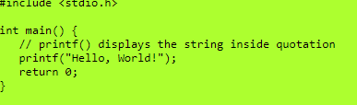
翻譯員
Translator
C language
compiler

Slide 4
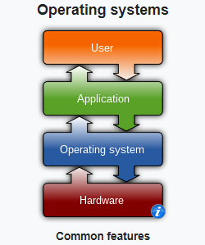

C program
Window 11

Slide 5

Command terminator,end of command,called semicolon
Assing 10 to vaibles x
One direction only

Slide 6
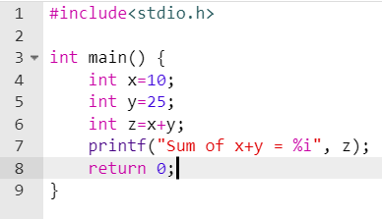
Curly baraces，大括號

Slide 7
Main function , the starting point of execution

Slide 8
Bring in library function

Slide 9
Home of a variable
In the view of hardware it ‘s a memory location with space to restore data.
Assing 10 to vaibles x
One direction only
Datatype
Integer ……-3,-2,-1,0,1,2,3,……
Rule-before using a variable must define it’s data type.

Slide 10
Data type of ariable
A. Before using a variable.
We must declare it’s data type.
B. The reason for example,our integer and character are same to the machines.

Slide 11
A is the control statement control format for presentation.

Slide 12
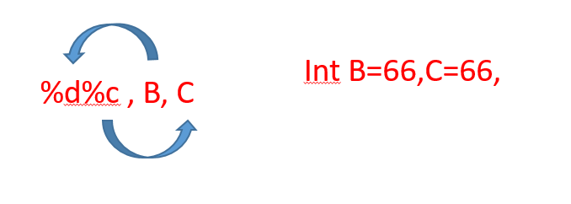
Printf( A, B, C, D)
A is the control statement control format for presentation.
B, C,…..are arguments; No control.

Slide 13
(1)
(2)
(3)

Slide 14
#include < > (1)
(2)Int main {
Printf(“ “); (3)
Return 0;
}

Slide 15
#include < > (1)
(2)Int main {
(3)
for(……………..){
(4)
}
}

Slide 16
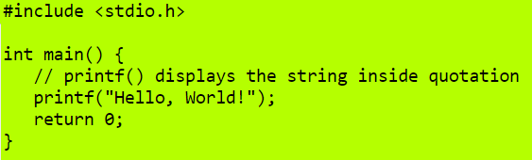
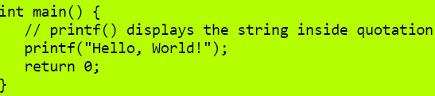


Box1
Box2
Box3
Box3

Slide 17
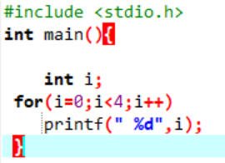
Programming statements
Types(類型)
execu. on statement like printf
Logica on statement like if…else
Looping on statement like for( )
(1) scope by braces
(2) statements inside braces
(3) will be executed for each iteration indexing variable
(4)looping condition , if true then continue
(5)looping update operation , EX: i++
EX: i++ meaning to increase 1 for each loop

Slide 18
A deeper concept about looping
Why variable for looping
EX for(i=0;i<4;i++){
for(j=0;j<4;j++) 4 times
}
(A)Looping expression (a standard format structure結構)
(表達式)
F(x),f(x,y),……..
Looping(i)=for(i=0;i<4;i++)
(1)init
(2)condition
(3)updates
(B) Real world (to see is to believe)
for(i=0;i<4;i++) 0123
printf(“*”); I ****X

Slide 19
* I\J 0 1 2 3
** 0 T F
*** 1 T T F
**** 2 T T T F
3 T T T T F
I\J 0 1 2 3
0 *
1 * *
2 * * *
3 * * * *

Slide 20
(1)
i\j 0 1 2 3
0 T F
1 T T F
2 T T T F
3 T T T T
(2)
i\j 0 1 2 3
0 T T T T
1 T T T F
2 T T F
3 T F
(3)
i\j 0 1 2 3
0 T T T T
1 F T T T
2 F F T T
3 F F F T
(4)
i\j 0 1 2 3
0 F F F T
1 F F T T
2 F T T T
3 T T T T

